Slide 1
AFCON 2025 Winner Prediction: Technical Analysis Report
Author: Dr. Victor Prefa, MBBS, MPH, MSc Data Science Date: December 27, 2025 Version: 1.0

Slide 3
PREDICTED WINNER: EGYPT (19.3% probability) Top 10 Predictions
🏆 | Country | Win Percentage | Reach Quarter | Reach Semi Final
1 | Egypt | 19.3% | 45.8% | 30.3%
2 | Nigeria | 11.2% | 35.7% | 20.5%
3 | Ivory Coast | 10.8% | 35.6% | 19.8%
4 | Cameroon | 10.5% | 34.2% | 19.8%
5 | Morocco | 9.8% | 34.3% | 19.2%
6 | Algeria | 6.4% | 27.6% | 14.2%
7 | Tunisia | 6.1% | 25.1% | 12.3%
8 | Senegal | 5.4% | 26.5% | 12.1%
9 | DR Congo | 5.4% | 25.1% | 11.8%
10 | Mali | 3.9% | 20.4% | 9.1%

Slide 4
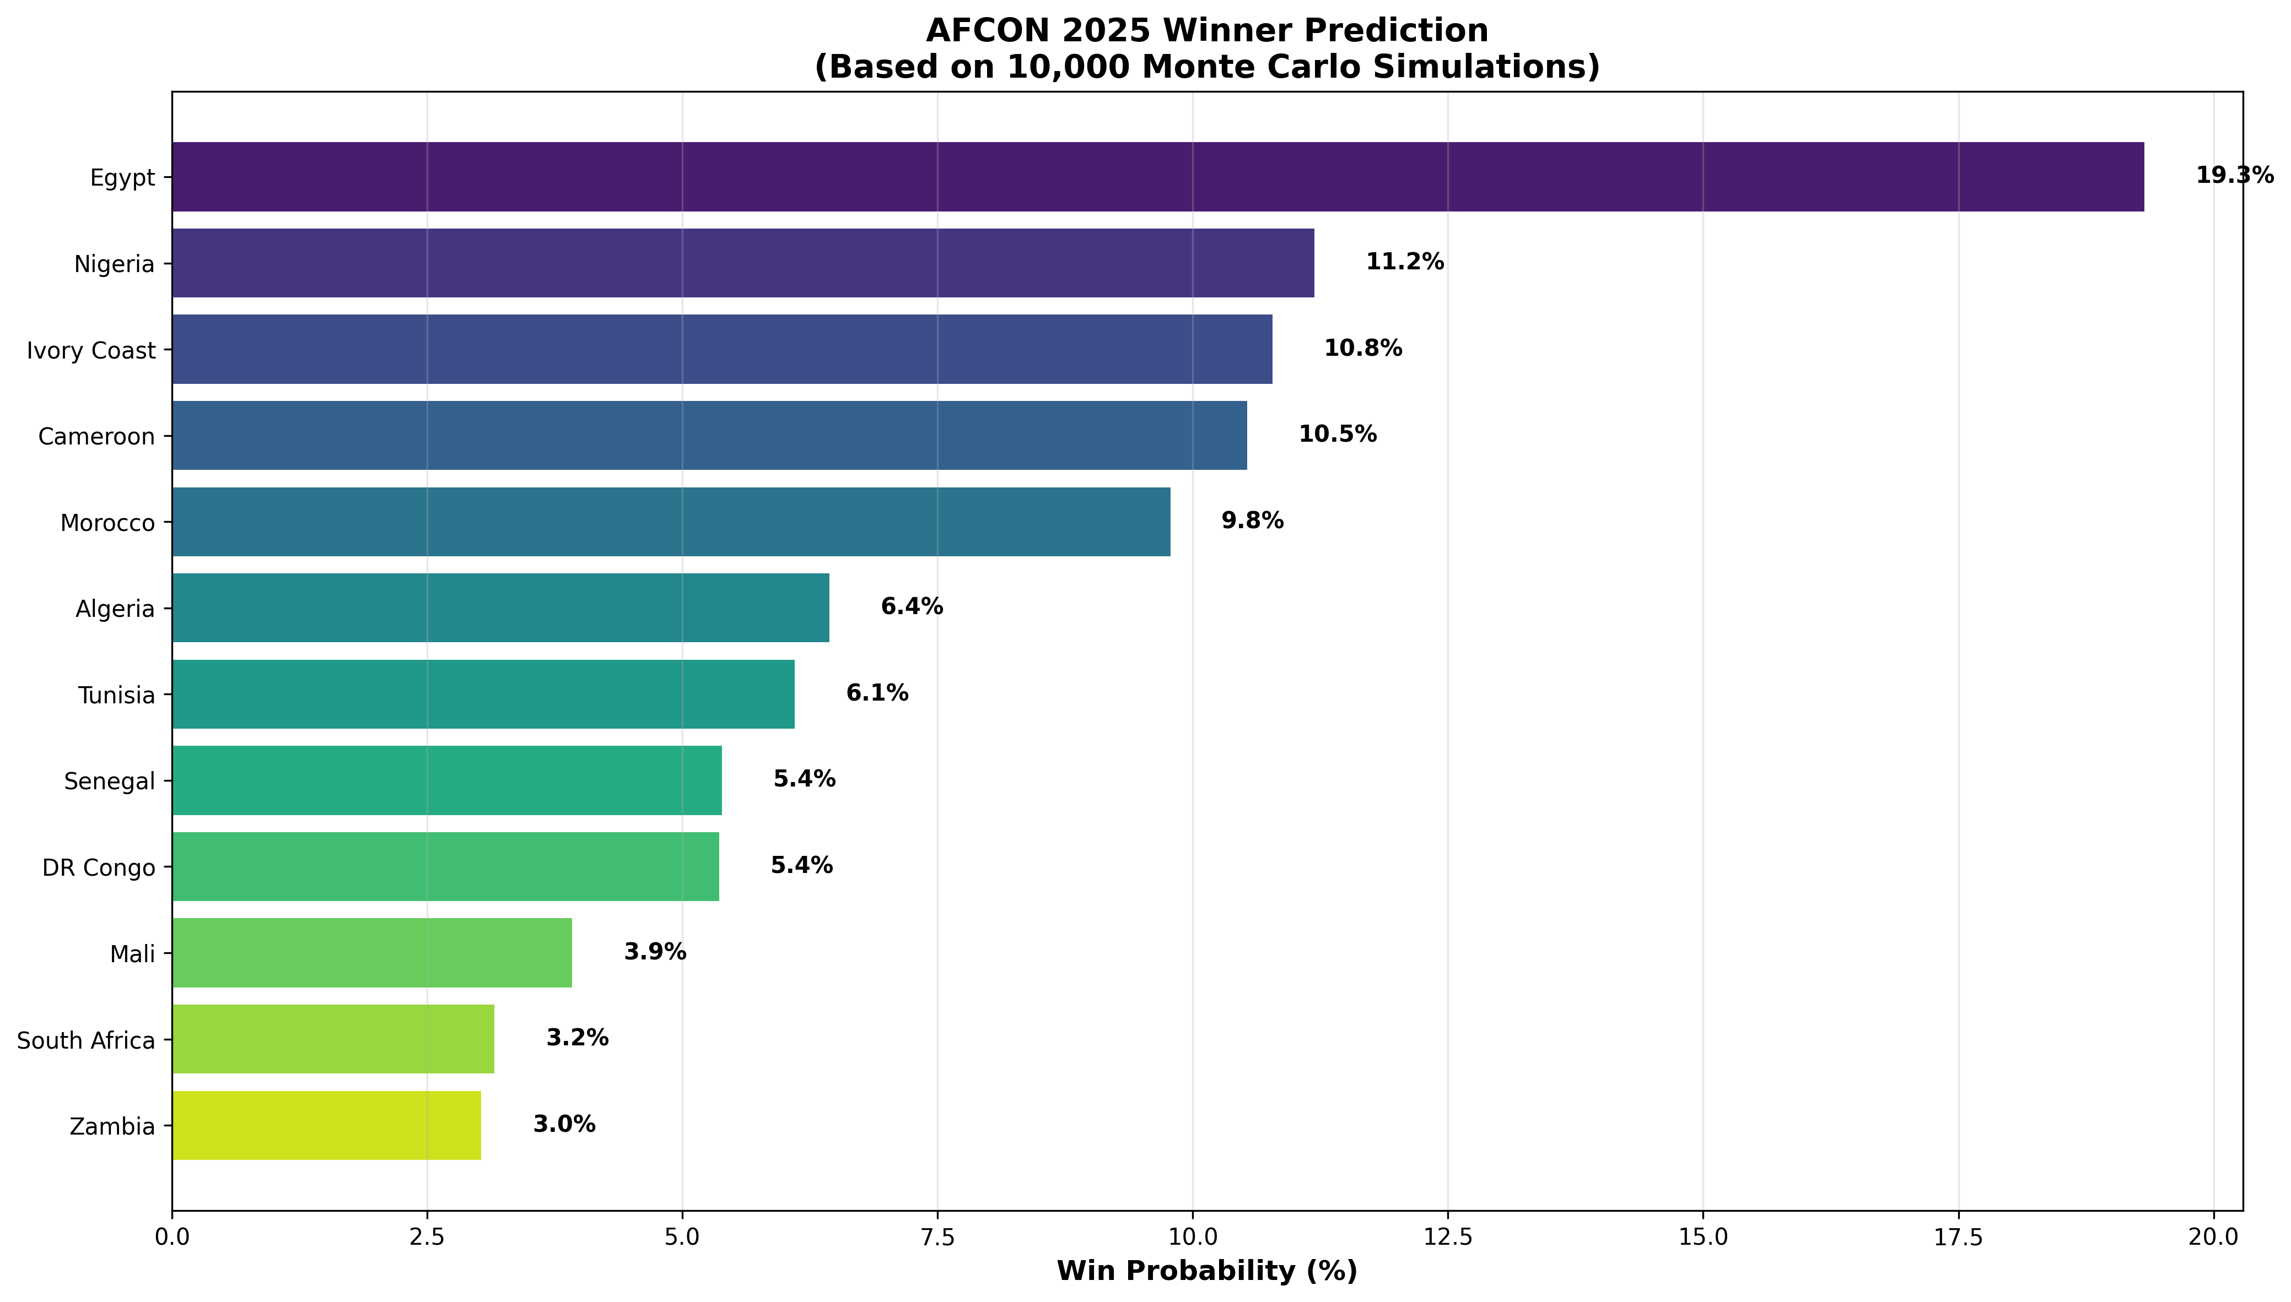

Slide 5

The Prestigious Cup

Slide 6
Why Egypt? 🥇
Unmatched Historical Dominance
7 AFCON titles
(most all-time)
26 tournament appearances
(most participations)
111 matches played
(most experience)
2.018 points per game
(highest efficiency)

Slide 7
Perfect Current Form
Group Stage 2025:
2 Wins, 0 Draws, 0 Losses-
Goals: 3 scored, 1 conceded
First team to qualify for Round of 16
📊 Statistical Excellence
175 total goals scored (all-time record)
93% qualification success rate
3 consecutive titles (2006, 2008, 2010)

Slide 8
Key Insights
🎯 The "Big 5" are Remarkably Close Teams ranked 2-5 (Nigeria, Ivory Coast, Cameroon, Morocco) have win probabilities within 1.4 percentage points (9.8% - 11.2%).
The above suggests knockout stages will be highly competitive and unpredictable.
🏠 Host Advantage is Real But Not Dominant
Morocco ranks 5th despite hosting because:- Only 1 historical AFCON title (1976)- Lower points-per-game than top 4
However: Host nations win ~47% historically

Slide 9
Underdogs to Watch
🌟 Dark Horses to Watch
Algeria (6.4%): 2 titles, strong recent form
Senegal(5.4%): Defending champions (2021)
DR Congo
(5.4%): 2 titles, unpredictable in knockouts

Slide 10

Methodology
Data Sources- Historical AFCON data (1957-2025): 65+ years- Current tournament results: Live group stage data-Tournament structure: 24 teams, 6 groups, knockout format
Model Features (22 total)
1.Performance Metrics: Wins, draws, losses, goals, points per game
2. Tournament Pedigree: Titles, appearances, qualification success3.
Current Form: 2025 group stage results4.
Contextual Factors: Host advantage, defensive solidity

Slide 11
StrengthIndex Formula
Score = 30% × PPG + 25% × Goal Diff + 15% × Clean Sheets + 10% × Qual Success + 10% × Experience + 10% × Host Bonus
Simulation Engine: Poisson distribution for goal modelling: 10,000 complete tournaments simulated- Accounts for group stage → R16 → QF → SF → Final- Penalty shootouts modelled probabilistically
Model Validation ✅ Strengths- 65+ years of comprehensive historical data
Transparent, interpretable methodology- 10,000 simulations ensure statistical robustness →→ Aligns with expert consensus

Slide 12

Interest
Limitations: Cannot predict injuries, tactical changes, or referee decisions
Does not include player-level statistics- Knockout football inherently high-variance- Simplified bracket structure
Clinical-Data Science Parallel As a physician and data scientist,
I recognize strong parallels:| Clinical Medicine | Football Analytics Patient history | Team historical performance || Current vital signs | Current tournament form || APACHE/SOFA scores | Strength index || Mortality probability | Win probability || Evidence-based | Data-driven || Never certain| Never certain |

Slide 13
Conclusion
Bottom Line
Egypt is the statistical favorite, but the tournament remains wide open.
The top 5 teams are separated by less than 10 percentage points. In knockout football, anything can happen.
This model provides evidence-based guidance, not prophecy.
May the best team win. 🏆⚽

Slide 14
Project Deliverables
✅ Complete Python codebase (450+ lines)
✅ Historical dataset (24 teams × 22 features)
✅ Monte Carlo simulation engine
✅ Professional visualizations
✅ Comprehensive technical documentation
✅ GitHub-ready repository structure
✅ LinkedIn publishing templates **Status:** Ready for portfolio/publication
✅*Connect: LinkedIn: [Dr. Victor Prefa]
GitHub: [https://github.com/23396784/-Project-AFCON-2025-Winner-Prediction.com/victor-prefa/afcon-2025-prediction]
Email: vprefa@gmail.com.com

